Slide 1






NDEAR - ONDC EDUCATION & SKILLING HACKATHON
Team ThinkArray
POWERED BY
SUPPORTED BY

Slide 2
Agenda
1. Team and Member Details
2. Problem Statement
3. Solution
User Journey
Flow Diagram
Solution Description
Architecture Diagram
4. Demonstration *
5. Appendix *
* These sections have been added after qualification to the 2nd rounds

Slide 3
Team and Member Details
ThinkArray
Contact Details (of POC)
mehrukh007@gmail.com
+91-9741343008
Member Details (Name, Email ID and Contact Number)
Rupa Kumari, rupk007@gmail.com, +91-9903432540
Shariq Azim, sharique.azim@gmail.com, +91-9038270120
Md Mehran Abul, mehrukh007@gmail.com, +91-9741343008
Tunir Saha, sahatunir@gmail.com, +91-8981423820
Challenge Category
Challenge Category 5

Slide 4
Problem Statement
We attempt to solve the following three problems:
Access to relevant blue collar jobs (Challenge Category 5)
Creating a framework to reach out to unskilled/low-skilled professionals via messages/ calls/WhatsApp with a short job description in their mother tongue and facilitate employer hiring

Slide 5
Access to relevant blue collar jobs (Challenge Category 5)

Slide 6
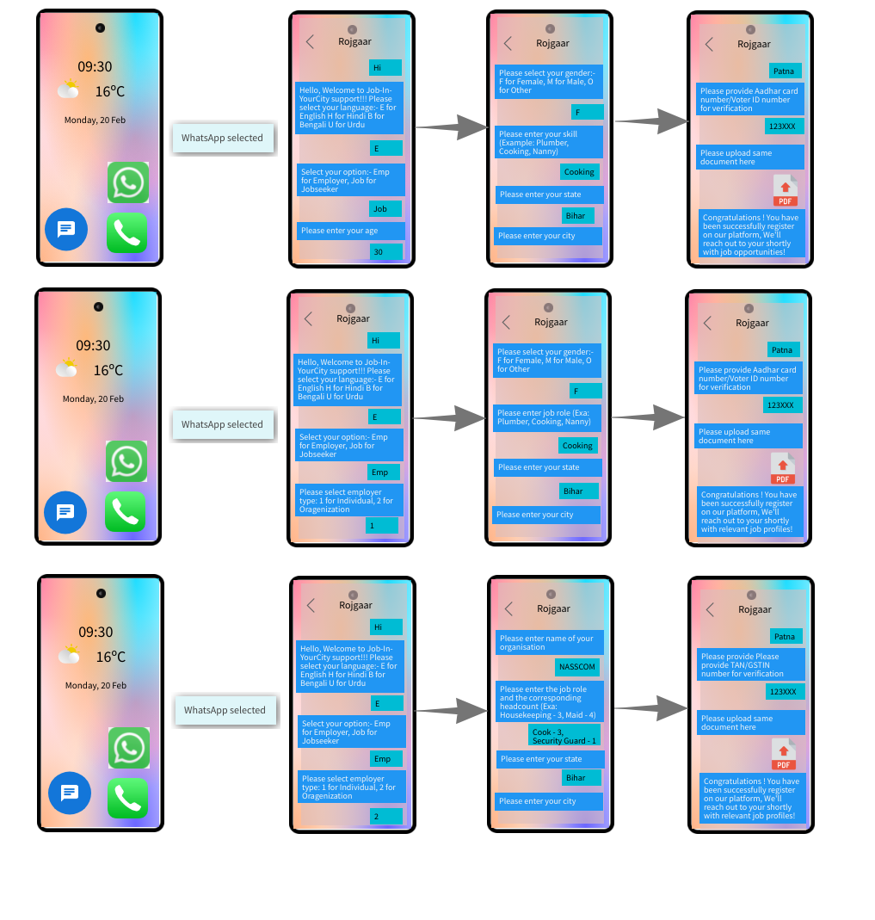
User Journey (Wireframe)
Job Seeker
Individual Employer
Large-sized Employer

Slide 7
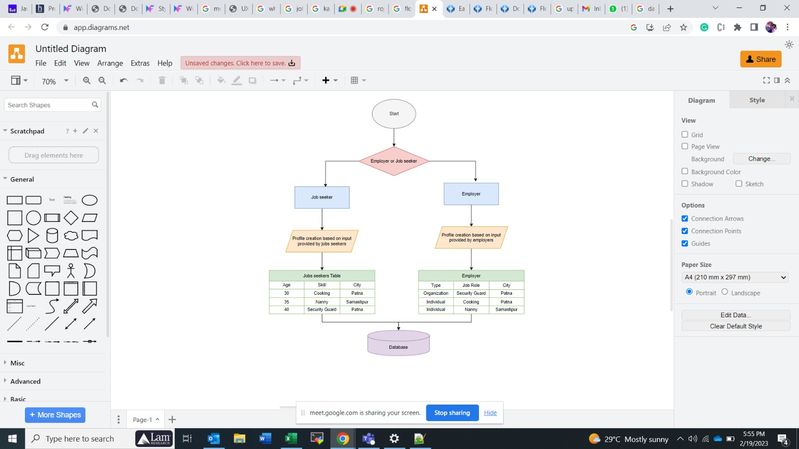
Flow Diagram

Slide 8
Solution
Blue collar workers form a large section of India’s workforce, which is estimated to be around 500 million of which 93% are unorganized
There is a need to organize it in order to make jobs accessible and the hiring process smooth for both the job seeker and employer
We propose to design and develop a text-call-chat framework for the recruitment process from both the demand and supply side.
We plan to create a system that enables low and unskilled professional register through text message, call or WhatsApp chat with a few very basic details. Likewise, employers can also register and post their requirements over WhatsApp. The above information would then be verified by a central team. After successful verification, using machine learning models, profiles would be matched with job requirements and job seekers would be sent a short description of the job role in a language of his/her preference along with contact details of the employer.
Key metrics: No. of applications, Applicant conversion rate, Application drop off rate, No. of chats, #No of job postings, #job openings every month
Frameworks/ technologies stacks: Python, machine learning, WhatsApp chat/API, call and messaging service
The idea revolves around the assumption that there exists systems that can validate government IDs
The solution is tech-based and hence highly scalable and has rich features to provide best usability

Slide 9
Architecture Diagram
Registration Channels
Call
Language Translation and summarization services - LTSS
(ML transformer based)
Job Seeker registration system (JSRS)
Central verification System
(CVS)
Job Matching System
(ML based system)
Text message
WhatsApp Chat
Employer registration System (ERS)
Communication Gateway
JSRS: Allows job seekers to enter their details via call, text message or WhatsApp chat. The data is stored in a database
ERS: Allows employers to enter details regarding job opportunities via WhatsApp chat. The data is stored in a database
CVS: Verifies the details provided by Job Seekers and Employers through the registration components
JMS: Matches the job opportunities with the applications using Machine Learning
LTSS: Summarizes the job description, translated it into the job seeker preferred language(s) using ML
Communication Gateway: Supports in passing the relevant job opportunities back to the job seekers via the registration channel(s)

Slide 10
Demonstration

Slide 11
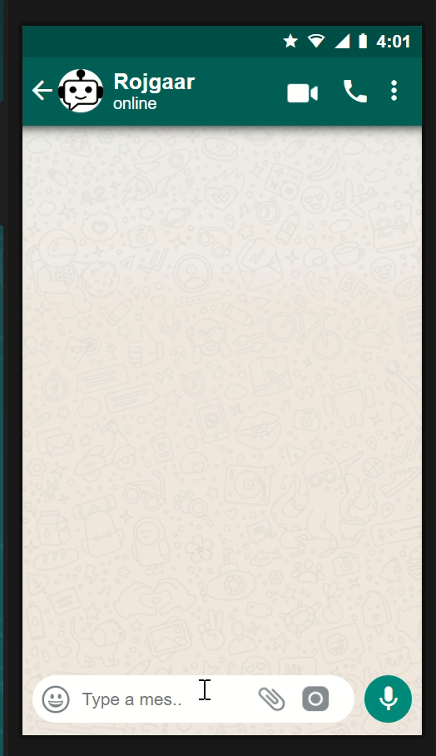
Job Seeker - Interface
Steps:
Choose Language
Select User Type
Enter Name
Enter the job particulars
Highlights:
Individual can, in no time, register on the Rojgaar platform, share their requirements and get details of relevant job seekers
You can try out the live application on :
https://skubotics.in/rojgaar/

Slide 12

Job Provide (Individual) - Interface
Steps:
Choose Language
Select User Type
Enter Name
Enter the job particulars
Highlights:
Individual can, in no time, register on the Rojgaar platform, share their requirements and get details of relevant job seekers
You can try out the live application on :
https://skubotics.in/rojgaar/

Slide 13
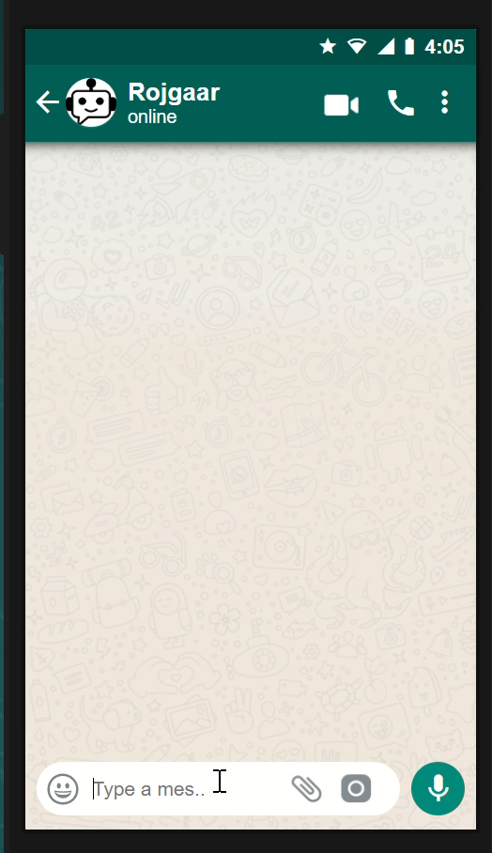
Job Provider (Organisation) - Interface
Steps:
Choose Language
Select User Type
Enter Name
Enter the job particulars
Highlights:
Individual can, in no time, register on the Rojgaar platform, share their requirements and get details of relevant job seekers
You can try out the live application on :
https://skubotics.in/rojgaar/

Slide 14
Appendix
Application Link: URL to the website that acts as an interface for job seekers and job providers and facilitates job creation and fulfillment
Rojgaar.sql: Our database that serves as the engine that stores all job related information and is the layer for all analysis and reporting
Script.zip: Contain the scripts for the UI and application
Job recommendation.ipynb: Python script that adopts cosines distance based measure to map job opportunities with appropriate candidates
Application Link : https://skubotics.in/rojgaar/

Slide 15
Thank you!
POWERED BY
SUPPORTED BY

